Slide 1
Dominos Project

Slide 2
Who are we?
Plamen Komitov
Chavdar Goranov

Slide 3
Main Functionalities
Register and login
Manage addresses and set address for order
View menu
Add and modify pizza to cart
Add other products to cart
Manage quantity of products in cart
View cart
Make an order
Receive an email with your receipt
Admin privileges for managing the menu

Slide 4
Technologies we used
Java 15
Spring Boot
Spring Rest
Maven
Hibernate
JPA
MySQL
BCrypt
Lombok
JavaMail
Model Mapper
JUnit
IntelliJ IDEA
Postman
Git

Slide 5
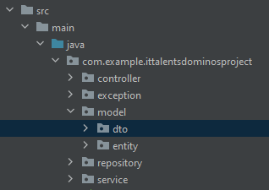
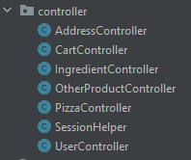
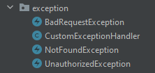
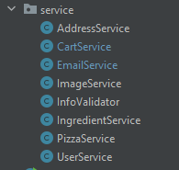
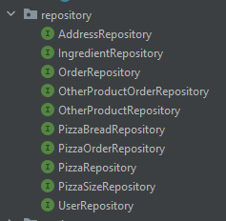
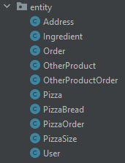
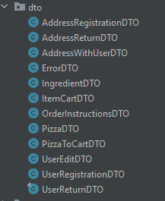
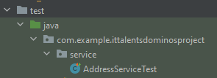
Class Structure

Slide 6
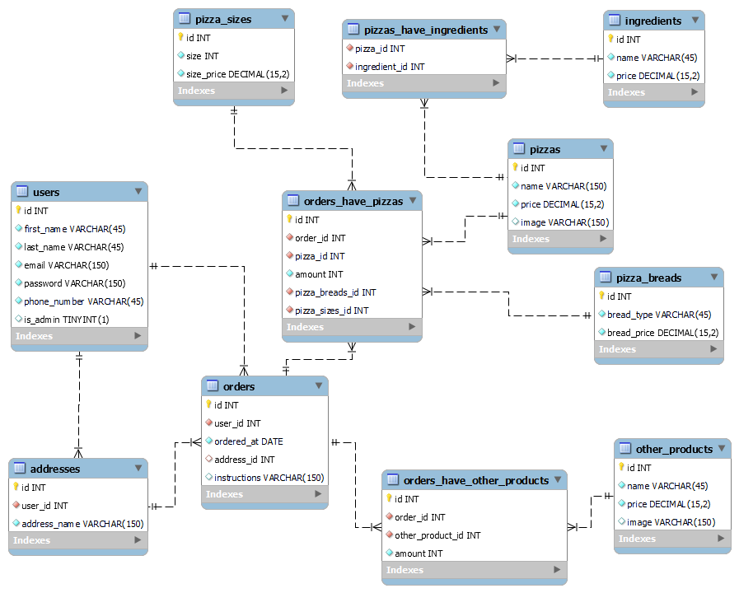
Database diagram

Slide 7
Demo
Thank you for your attention!
Questions?

